Slide 1

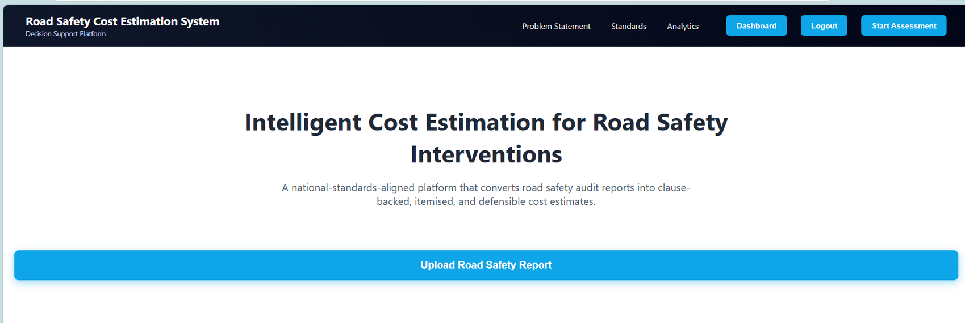
AI powered Cost Estimation for Road Safety Interventions
K. Madhuri - AM.SC.U4AIE23117

Slide 2


Introduction
  Road safety is a critical issue in India, with over 150,000 fatalities every year due to road accidents.
  Road Safety Audits are conducted to identify hazardous locations and recommend safety improvements.
  These audit reports are available in PDF format with mixed structures like tables, bullet points, and text.
  Currently, engineers manually extract interventions, refer to IRC standards, and estimate costs using CPWD SOR.
  This process is time-consuming (4–6 hours per report), error-prone, and inefficient.
3

Slide 3
Problem Statement
  Manual extraction of interventions leads to high effort and human errors.
  PDF reports have inconsistent formats, making automated parsing difficult.
  Identifying correct IRC clauses requires manual lookup, which is time-consuming.
  Cost estimation using CPWD SOR is tedious and prone to inaccuracies.
  Lack of a centralized system makes storage and retrieval of reports difficult.
Objectives
  Automate the extraction of interventions from road safety audit PDFs.
  Handle multiple PDF formats using a dual-mode parsing approach.
  Automatically map interventions to IRC clauses using intelligent matching.
  Develop a cost estimation engine based on CPWD Schedule of Rates.
  Provide a user-friendly dashboard to store, edit, and manage reports.
  Reduce processing time from hours to seconds, improving efficiency and accuracy.
4

Slide 4
Proposed Solution Overview
  Developed Road-Safety Cost Estimation System
  AI-powered web application to automate Road Interventions report processing
  Allows users to:
- Upload PDF reports
- View extracted interventions
- Estimate project costs
- Save and manage reports
  Provides a centralized platform for road safety analysis
  Extracts interventions from PDFs → maps to IRC → estimates cost
  Built using MERN stack + Python AI microservice
  Generates structured, editable, exportable reports
5

Slide 5
Key Innovation:
  Dual-mode parser:
- Chainage-based extraction (high accuracy)
- Fallback point-wise extraction
  Fuzzy matching for automatic IRC clause identification
  Automated cost estimation using SOR rates published by government
  Reduces manual effort in report processing
High-Level Working:
  User uploads PDF through frontend
  Backend sends file to processing service
  Data is extracted and structured
  Cost is calculated based on rules
  Results displayed on UI
  Reports stored in database for reuse
5

Slide 6
Tech Stack and associated software
Technologies Used:
  Frontend: React.js, React Router, Axios
  Backend: Node.js, Express.js
  Database: MongoDB (Atlas)
  Authentication: JWT, bcrypt
Supporting Tools:
  Python (for processing service)
  FastAPI (microservice integration)
  Recharts (data visualization)
6

Slide 7
System Architecture and Workflow
User Login
↓
Upload PDF
↓
Frontend sends request to Backend
↓
Backend processes file / forwards to processing service
↓
Extracted data returned as JSON
↓
Backend stores data in MongoDB
↓
Frontend displays results
↓
Interventions + Cost Details
↓
User edits / analyzes / exports report
React Frontend
(UI, Upload, Dashboard)
Node.js + Express API
(Logic & Control flow)
MongoDB
(Database)
Processing Service
(Data Extraction)
7

Slide 8
Major Modules / Components
AI Processing Module:
  Extracts data from PDF
  Intervention detection
  IRC matching
  Cost estimation
  Sends structured output
Database (MongoDB):
  User data
  Report storage
Frontend (React):
  Upload Page
  Results Page
  Summary & Analytics
  Dashboard
Backend (Node.js/Express):
  Authentication module
  Report management (CRUD)
  API handling
7

Slide 9
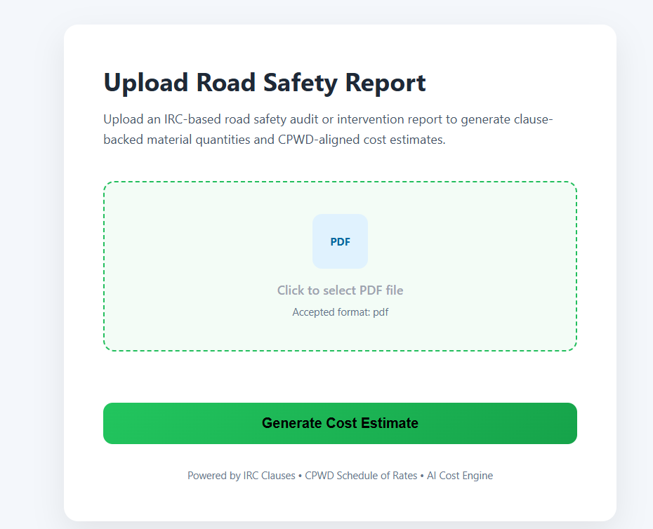
Implementation Details
Key Features Implemented:
  Secure user authentication (JWT)
  PDF upload and processing
  Dynamic data display using React components
  Editable results with real-time updates
  Database integration (MongoDB)
  Dashboard to manage reports
  Data visualization using charts
UI / Output Features:
  User-friendly interface
  Drag-and-drop file upload
  Interactive results table
  Summary dashboard with key metrics
  Graphical representation of data
  Export report functionality
Pdf upload page
8

Slide 10
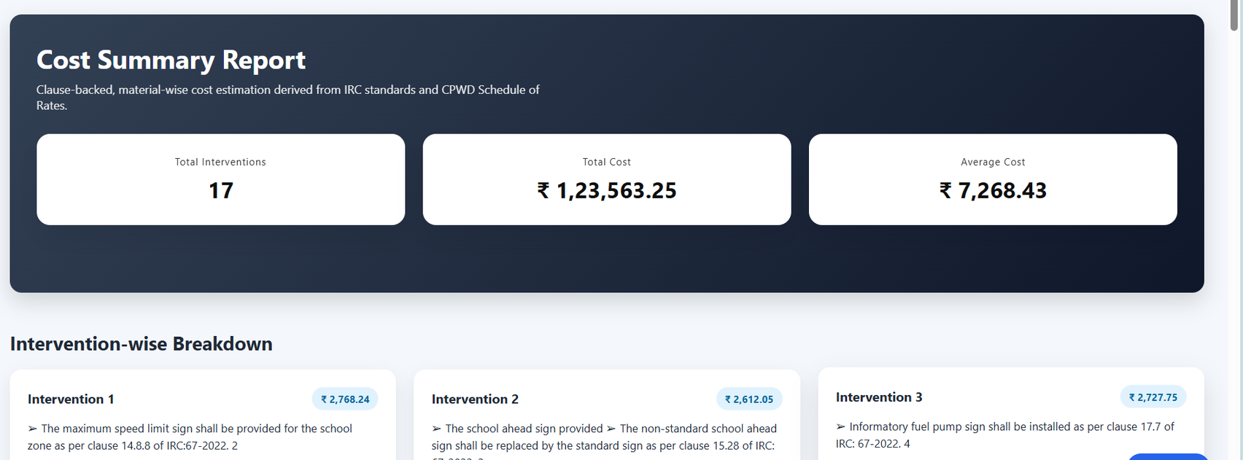
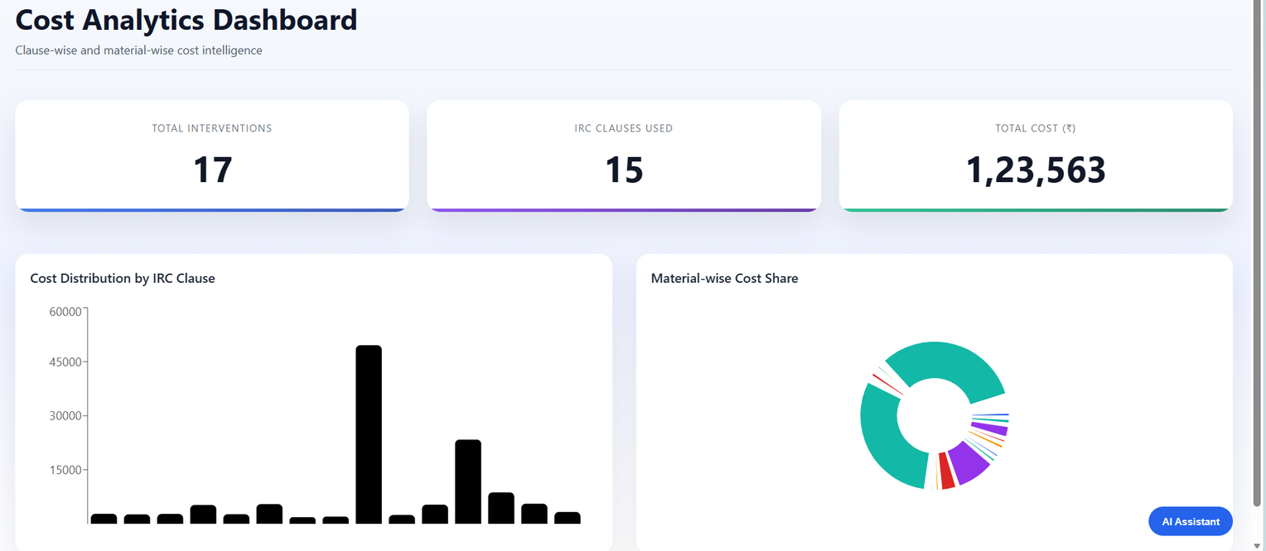
Cost estimation page
Analytics page
8

Slide 11
Evaluation & Analysis(with existing project)
Output / Results Obtained
  System successfully extracts road safety interventions from PDFs
  Generates structured JSON output with:
    Intervention details
    Chainage (if available)
    Cost estimation
  Provides:
    Editable results table
    Summary with total cost
    Graphical analytics
  Reports can be stored, retrieved, and exported
Strengths:
  Full-stack integrated system (MERN)
  Fast and automated processing
  Handles real-world PDF variations
  User-friendly dashboard
  Reduces human errors
Limitations:
  Accuracy depends on PDF quality
  Complex layouts may affect extraction
  Cost estimation is rule-based (not fully dynamic)
  Requires internet for full functionality
9

Slide 12
Evaluation & Analysis(with existing project)
How Solution Meets Objectives:
  Automated extraction
  Handles multiple formats
  Cost estimation
  Centralized dashboard
  Reduced time & effort
Comparison with Existing Methods:
Feature | Manual Method | Basic Tools | Proposed System
Time Required | 4–6 hrs | 30–45 mins | Few seconds
Accuracy | High (human) | Medium | High
Format Handling | Yes | Limited | Yes
Automation | No | Partial | Full
Storage | No | No | Yes
9

Slide 13
Challenges & Solutions
  Handling different PDF formats
→ Implemented dual extraction approach (table + point-wise)
  Data inconsistency in reports
→ Used flexible parsing and fallback mechanisms
  Backend integration with processing service
→ Used API-based communication (FastAPI + Express)
  Managing large data and reports
→ Used MongoDB for efficient storage
  While processing cost and materials data
→ Used AI sentence transformers to process data from large pdfs
10

Slide 14
Conclusion
  Developed a full-stack MERN-based application for road safety analysis
  Automated a time-consuming manual process
  Improved efficiency, accuracy, and usability
  Provided a centralized platform for report management
  Demonstrated integration of web technologies with automation features
11

Slide 15
Future Scope
  Improve accuracy using advanced AI/ML models
  Support more complex and diverse document formats
  Add real-time collaboration features
  Integrate with government road safety databases
  Develop a mobile application version
  Enhance analytics with predictive insights
12

